Slide 1
18ITT42 - DESIGN AND ANALYSIS OF ALGORITHMS
(IV-Semester)
Velalar College of Engineering and Technology
(Autonomous)
Department of CSE
(Accredited by NBA)
Handled By:
Dr.V.Latha Jothi , Professor

Slide 2
UNIT – II
Analysis of Sorting and Searching Algorithms
Brute Force – Selection Sort and Bubble Sort - Divide and conquer – Merge sort – Quick Sort-Strassen‟s Matrix Multiplication -Decrease and Conquer – Insertion Sort–Transform and Conquer-Heaps and Heap sort- Analysis of Linear Search and Binary search techniques

Slide 3
DIVIDE AND CONQUER
Divide-and-conquer is probably the best-known general algorithm design Technique.
Divide-and-conquer algorithms work according to the following general plan:
  A problem is divided into several sub-problems of the same type, ideally of about equal size.
  The sub-problems are solved separately
  The solutions to the sub-problems are combined to get a solution to the original problem.

Slide 4
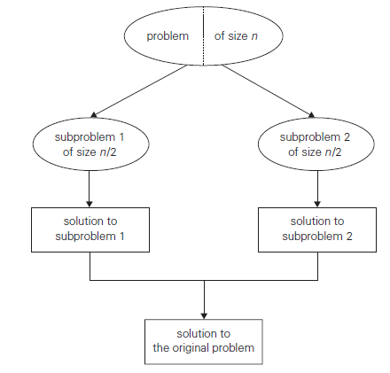

Slide 5
MERGE SORT

Slide 6
MERGE SORT
Mergesort is a perfect example of a successful application of the divide and conquer technique.
It sorts a given array A[0..n − 1] by dividing it into two halves A[0..n/2 − 1] and A[n/2..n − 1], sorting each of them recursively, and then merging the two smaller sorted arrays into a single sorted one

Slide 7
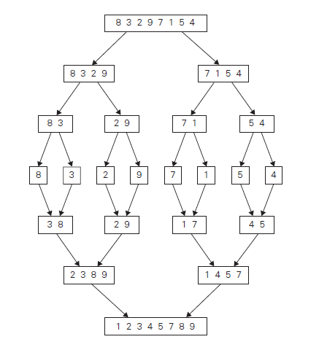

Slide 8
Merge Sort
ALGORITHM Mergesort(A[0..n − 1])
//Sorts array A[0..n − 1] by recursive mergesort
//Input: An array A[0..n − 1] of orderable elements
//Output: Array A[0..n − 1] sorted in nondecreasing order
if n > 1
copy A[0..floor(n/2) − 1] to B[0.. floor(n/2) − 1]
copy A[floor(n/2)..n − 1] to C[0..ceil(n/2) − 1]
Mergesort(B[0..floor(n/2) − 1])
Mergesort(C[0..ceil(n/2) − 1])
Merge(B, C, A)

Slide 9
Merge Sort
ALGORITHM Merge(B[0..p − 1], C[0..q − 1], A[0..p + q − 1])
//Merges two sorted arrays into one sorted array
//Input: Arrays B[0..p − 1] and C[0..q − 1] both sorted
//Output: Sorted array A[0..p + q − 1] of the elements of B and C
i ←0; j ←0; k←0
while i < p and j < q do
if B[i] ≤ C[j ]
A[k]←B[i]; i ←i + 1
else
A[k]←C[j]; j ←j + 1
k←k + 1
if i = p copy C[j..q − 1] to A[k..p + q − 1]
else copy B[i..p − 1] to A[k..p + q − 1]

Slide 10
Analysis of Merge Sort
The recurrence relation for the number of key comparisons C(n) is
C(n) = 2C(n/2) + C_{merge}(n) for n > 1, C(1) = 0.
Here C_{merge}(n), the number of key comparisons performed during the merging stage.
At each step, exactly one comparison is made, after which the total number of elements in the two arrays still needing to be processed is reduced by 1. In the worst case, neither of the two arrays becomes empty before the other one contains just one element. Therefore, for the worst case,
C_{merge}(n) = n − 1.
C_{worst}(n) = 2C_{worst}(n/2) + n − 1 for n > 1, C_{worst}(1) = 0.

Slide 11
Analysis of Merge Sort
According to the Master Theorem,
C_{worst}(n) = 2C_{worst}(n/2) + n − 1
Here a = 2; b = 2; d = 1
b^{d} = 2¹ = 2;
Therefore a = b^{d}; T(n) ∈ Θ(n^{d} log n)
C_{worst}(n) ∈ Θ(n log n)

Slide 12
QUICK SORT

Slide 13

QUICK SORT
Quicksort is the other important sorting algorithm that is based on the divide-and-conquer approach.
Quicksort divides the inputs according to their value.
A partition is an arrangement of the array’s elements so that all the elements to the left of some element A[s] are less than or equal to A[s], and all the elements to the right of A[s] are greater than or equal to it:

Slide 14
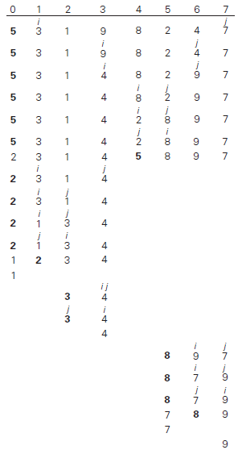

Slide 15
Quick Sort
ALGORITHM Quicksort(A[l..r])
//Sorts a subarray by quicksort
//Input: Subarray of array A[0..n − 1], defined by its left and right indices l and r
//Output: Subarray A[l..r] sorted in non-decreasing order
if l < r
    s ←Partition(A[l..r]) //s is a split position
    Quicksort(A[l..s − 1])
    Quicksort(A[s + 1..r])

Slide 16
Quick Sort
ALGORITHM Partition(A[l..r])
//Partitions a subarray using the first element as a pivot
//Input: Subarray of array A[0..n − 1], defined by its left and right indices l and r (l<r)
//Output: Partition of A[l..r], with the split position returned as this function’s value
p←A[l]
i ← l; j ← r + 1
repeat
    repeat i ← i + 1 until A[i] ≥ p
    repeat j ← j − 1 until A[j ] ≤ p
    swap(A[i], A[j ])
until i ≥ j
swap(A[i], A[j]) //undo last swap when i ≥ j
swap(A[l], A[j])
return j

Slide 17
Analysis of Quick Sort
After making n + 1 comparisons to get to the partition and exchanging the pivot A[0] with itself, the algorithm will be left with the strictly increasing array A[1 .. n − 1] to sort.
This sorting of strictly increasing arrays of diminishing sizes will continue until the last one A[n − 2 .. n − 1] has been processed.
The total number of key comparisons made will be equal to

Slide 18
Strassen’s Matrix Multiplication

Slide 19
Multiplication of Two Numbers
Multiply 23 and 14
Here 23 = 2 . 10¹ + 3 . 10⁰ and 14 = 1 . 10¹ + 4 . 10⁰.
23 ∗ 14 = (2.10¹ + 3.10⁰) ∗ (1.10¹ + 4.10⁰)
= (2∗1)10² + (2∗4 + 3∗1)10¹ + (3 ∗ 4)10⁰.
= 322, of course, but it uses the same
Above method need four multiplications
But, the products 2 ∗ 1 and 3 ∗ 4 that need to be computed anyway; so middle term can be written as
2 ∗ 4 + 3 ∗ 1= (2 + 3) ∗ (1+ 4) − 2 ∗ 1− 3 ∗ 4.
Therefore, for any pair of two-digit numbers a = a₁a₀ and b = b₁b₀, their product c can be computed by the formula
c = a ∗ b = c₂10² + c₁10¹ + c₀,
where,
  c₂ = a₁ ∗ b₁ is the product of their first digits,
  c₀ = a₀ ∗ b₀ is the product of their second digits,
  c₁ = (a₁ + a₀) ∗ (b₁ + b₀) − (c₂ + c₀) is the product of the sum of the
  a’s digits and the sum of the b’s digits minus the sum of c₂ and c₀.

Slide 20
Multiplication of Two Numbers
Multiplying two n-digit integers a and b
Denote the first half of the a’s digits by a₁ and the second half by a₀; for b, the notations are b₁ and b₀, respectively.
In these notations, a = a₁a₀ implies that a = a₁10^{n/2} + a₀ and
b = b₁b₀ implies that b = b₁10^{n/2} + b₀.
Therefore,
    c = a ∗ b = (a₁10^{n/2} + a₀) ∗ (b₁10^{n/2} + b₀)
    = (a₁ ∗ b₁)10^{n} + (a₁ ∗ b₀ + a₀ ∗ b₁)10^{n/2} + (a₀ ∗ b₀)
    = c₂10^{n} + c₁10^{n/2} + c₀,
    where
      c₂ = a₁ ∗ b₁ is the product of their first halves,
      c₀ = a₀ ∗ b₀ is the product of their second halves,
      c₁ = (a₁ + a₀) ∗ (b₁ + b₀) − (c₂ + c₀) is the product of the sum of the a’s
      halves and the sum of the b’s halves minus the sum of c₂ and c₀.

Slide 21
Multiplication of Two Numbers
The recurrence for the number of multiplications M(n) is
M(n) = 3M(n/2) for n > 1, M(1) = 1.
Solving it by backward substitutions for n = 2^{k} yields
M(2^{k}) = 3M(2^{k−1})
= 3[3M(2^{k−2})]
= 3²M(2^{k−2})
In general,
M(2^{k}) = 3^{i}M(2^{k−i})
= 3^{k}M(2^{k−k}) = 3^{k}.
since k = log₂ n,
M(n) = 3^{log}₂^{n} = n^{log}₂³ ≈ n^{1.585}. [property of logarithms: a^{log}_{b}^{c} = c^{log}_{b}ª]
M(n) = n^{1.585} against n² for normal multiplication

Slide 22
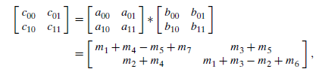
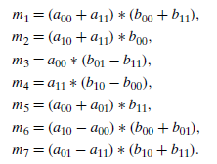
Strassen’s Matrix Multiplication
To find the product C of two 2 × 2 matrices A and B with just seven multiplications as opposed to the eight required by the brute-force algorithm
Here

Slide 23
Strassen’s Matrix Multiplication
Strassen’s Matrix Multiplication requires seven multiplications and 18 additions/subtractions, whereas the brute-force algorithm requires eight multiplications and four additions
So for any matrix A and B be two n × n matrices where n is a power of 2.
Here M(n) = 7M(n/2) for n > 1, M(1) = 1.
Since n = 2^{k}
M(2^{k}) = 7M(2^{k−1})
= 7[7M(2^{k−2})]
= 7²M(2^{k−2})
In general
M(2^{k}) = 7^{i}M(2^{k−i})
Let i=k
M(2^{k}) = 7^{k}M(2^{k−k}) = 7^{k}M(2⁰) = 7^{k}
But k = lon₂n
M(n) = 7 ^{lon}₂^{n =} n ^{lon}₂⁷ = n^{2.807}
which is lesser than n³ of normal matrix multiplication

Slide 24
THANK YOU

